Slide 1

INTRODUCTION TO
INCEPTION NETWORK
By
Zarni Nway Oo
Phyo Myat Oo
Nu Wai Thet

Slide 2

MOTIVATION BEHIND INCEPTION CNN
The Problem: Bigger ≠ Better
Early CNN designs :
Made deeper and wider networks to improve accuracy.
But... More depth & width → more parameters → problems
Problem | Why it matters
Overfitting | Too many parameters + limited data = poor generalization
Computational Cost | Large filters like 5×5 or 7×7 are expensive
Inefficient use of resources | Many weights may learn "nothing useful”
The Goal
“Can we design a CNN that is both accurate and efficient, without blindly stacking layers?”

Slide 3
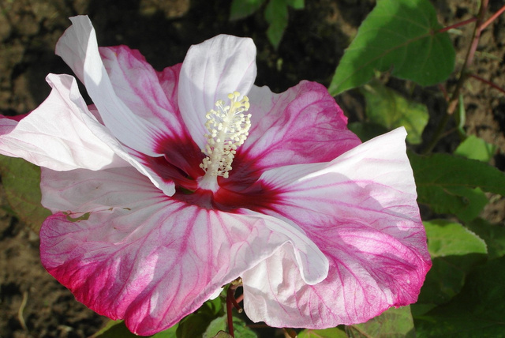




MOTIVATION BEHIND INCEPTION CNN
Challenge
Real-world images contain features at multiple scales — small details and large objects may appear in the same scene.
Should we use small filters (like 1×1), medium filters (3×3), or large ones (5×5)?
Key Idea: multi-scale feature extraction
Apply multiple filter sizes in parallel
→ 1×1, 3×3, 5×5 convolutions and pooling
This allows the network to capture diverse features at different spatial resolutions
But... Computational Cost Is High!
Larger filters (like 5×5) are expensive
Adding many parallel paths can explode the number of computations
Solution: Inception Architecture
Use multiple filter sizes in parallel
Apply 1×1 convolutions to reduce input depth before expensive filters
Combine all outputs into a richer, multi-scale feature set
→ This is the Inception Module (explained in next slide)

Slide 4

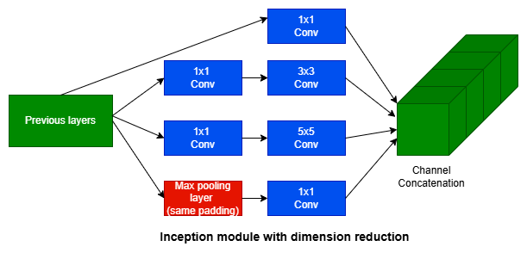
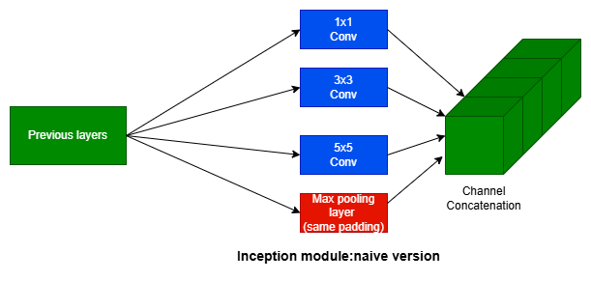
WHAT IS AN INCEPTION MODULE?
Instead of choosing one filter size, why not apply multiple filter sizes at once, in parallel?
Each kernel captures features at a different scale:
1×1 → fine local detail
3×3 → medium patterns
5×5 → large patterns
Max Pooling → spatial context / robustness
All outputs are concatenated (depth-wise) into one output tensor.
Combining features from different scales → richer and more robust representations.

Slide 5
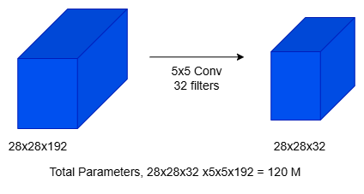
THE PROBLEM OF COMPUTATIONAL COST

Slide 6
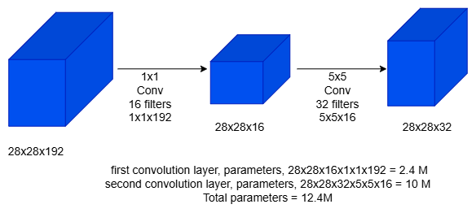
USING 1 X 1 CONVOLUTION
Without 1×1:
Input (192) → 5×5 conv → Computationally Expensive
With 1×1:
Input (192) → 1×1 conv → Computationally Much cheaper
Parallel Processing = multiple perspectives of the same image region.
1×1 Conv acts as:
Dimension reduction before expensive 3×3 and 5×5 convolutions
Non-linearity injector (ReLU after 1×1 conv)

Slide 7

BENEFITS OF
INCEPTION MODULE
1
Multiple kernel sizes
Capture multi-scale features
2
1x1 Conv
Reduces computation & adds depth
3
Parallel paths
Richer representation
4
Flexible design
Easy to balance accuracy vs speed

Slide 8
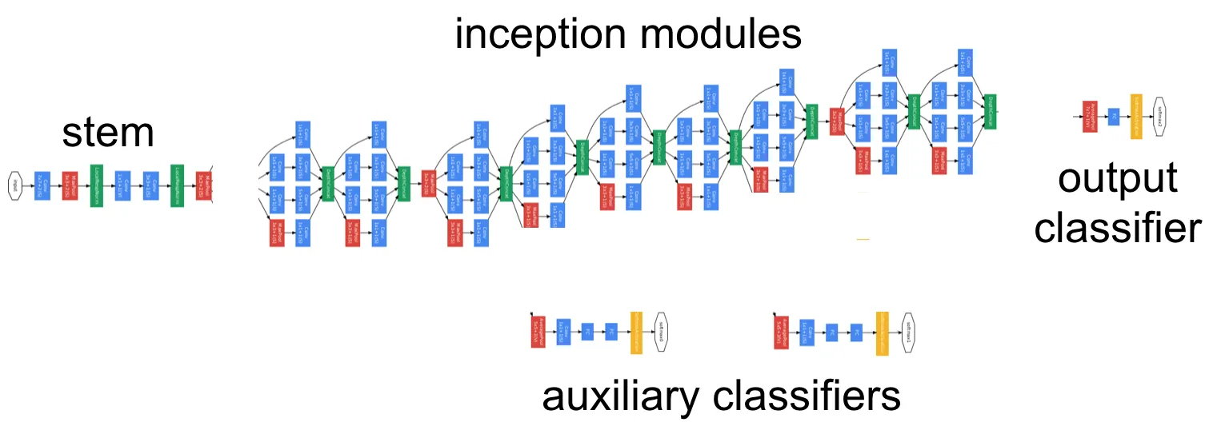
INCEPTION ARCHITECTURE – GOOGLENET
Overall Structure
GoogLeNet = Stacked Inception modules with some traditional conv & pooling layers.
GoogLeNet is a deep convolutional neural network built using 9 Inception modules.
Total Layers: 22
Key Feature: Uses stacked Inception modules to increase depth and width without computational blow-up
Introduces global average pooling before the final fully connected layer, reducing the number of parameters compared to traditional deep FC layers.

Slide 9
AUXILIARY CLASSIFIERS IN GOOGLENET
Deep networks (like GoogLeNet with 22 layers) can suffer from:
Vanishing gradients during backpropagation
Slow or unstable training
Solution: Add Small Classifiers in the Middle
Acts like "intermediate supervision"
Helps improve gradient flow to lower layers
Adds regularization during training
What Are Auxiliary Classifiers?
An auxiliary classifier is like adding a mini neural network in the middle of the big one. It:
Takes the output of an intermediate layer
Applies some layers: pooling → 1x1 conv → FC → softmax.
Tries to predict the final class — just like the main classifier.
Benefits:
🌊 Better gradient flow : Helps train earlier layers
🧩 Regularization: Reduces overfitting
⚡ Faster convergence: Training stabilizes sooner
Think of them as “training helpers,” not part of the final model

Slide 10
TRAINING METHODOLOGY & RESULTS (ILSVRC 2014)
Training Setup
Framework: DistBelief (CPU-based distributed training)
Optimizer: Asynchronous SGD + 0.9 momentum
Learning rate: Decreased 4% every 8 epochs
Final model: Polyak Averaging (smooths model parameters)
Data Augmentation Techniques
Multi-scale random crops (8%–100% of image area)
Random aspect ratios (from ¾ to 4/3)
Photometric distortions (color jittering)
Random interpolation (bilinear, area, nearest, cubic)
Testing Strategy
Ensemble of 7 GoogLeNet models
Aggressive multi-crop testing (144 crops/image)
Simple averaging of softmax scores across models & crops
🏆 Results: ILSVRC 2014
MetricValue
Top-5 Error 6.67% (1st place)
Training Images ~1.2 million
No external data used ✅

Slide 11
EVOLUTION OF INCEPTION MODELS (V1 → INCEPTION-RESNET‑V2)
Model | Key Innovations | Architectural Highlights | Training Improvements | Impact & Benefits
Inception‑V1 (GoogLeNet, 2014) | Introduced the Inception Module: parallel convolutions (1×1, 3×3, 5×5) + pooling | Used 1×1 convolutions to reduce depth before expensive ops; included auxiliary classifiers | Used Dropout, global average pooling instead of FC layers | Reduced parameters vs. VGG, efficient computation, top-5 ImageNet accuracy: 93.3%
Inception‑V2 (2015) | Factorized convolutions: replaced 5×5 with two 3×3 layers; introduced asymmetric convolutions (1×n + n×1) | Removed 5×5 filters entirely; widened inception modules for better capacity | Added Batch Normalization to improve convergence and stability | Lower computation cost, faster training, better regularization
Inception‑V3 (2015) | Factorized 7×7 convolutions into 1×7 + 7×1; improved module design | Deeper and more efficient modules with extensive factorization | Added Label Smoothing, switched to RMSprop optimizer | Significant accuracy gains; top-1 ImageNet error reduced to ~22%
Inception‑V4 (2016) | Modular redesign: separated into Inception-A/B/C and Reduction blocks | More structured and deeper architecture | Standardized modules, improved network clarity | State-of-the-art performance with more depth, better suited for large-scale training
Inception‑ResNet‑V2 (2016) | Merged Inception blocks with Residual Connections from ResNet | Used skip connections inside inception modules | Faster training, deeper networks with less vanishing gradient | Combined benefits of ResNet + Inception; one of the best models on ImageNet

Slide 12
CONCLUSION & KEY TAKEAWAYS – INCEPTION (GOOGLENET)
🔑 Why Inception Was a Breakthrough
Introduced multi-scale processing within a single module
Used 1×1 convolutions to reduce cost without losing performance
Achieved depth & width efficiently without computational explosion
📊 Performance Highlights
1st place in ILSVRC 2014 (Classification: 6.67% Top-5 Error)
1st place in Detection (43.9% mAP) — even without bounding box refinement
🧠 Smart Design Choices
Auxiliary classifiers improve gradient flow + regularization
Ensembles + aggressive crop testing boost final accuracy
Carefully balanced depth, width, and compute cost
🌱 Legacy & Impact
Inspired later models (e.g., Inception v2, v3, v4)
Sparked a shift toward modular, efficient architectures
Proof that dense approximations of sparse structures can scale
💡 Inception showed it's not just about going deeper — it's about going smarter.

Slide 13

THE INSPIRATION BEHIND THE NAME: WE NEED TO GO DEEPER
The meme “We need to go deeper” comes from the movie Inception — specifically from the character Dom Cobb (Leonardo DiCaprio) — and became a popular internet meme.
🎓 “Yes, the original paper literally references the movie and the meme: ‘We need to go deeper.’”
📚 Meme on KnowYourMeme: https://knowyourmeme.com/memes/we-need-to-go-deeper
Your paragraph text

Slide 14

THANK YOU

